Slide 1
Support Vector Machine & Its Applications
A portion (1/3) of
the slides are taken from
Prof. Andrew Moore’s
SVM tutorial at
http://www.cs.cmu.edu/~awm/tutorials

Slide 2
α
Linear Classifiers
x
f
y^{est}
f(x,w,b) = sign(w x + b)
denotes +1
denotes -1
w x + b>0
w x + b=0
How would you classify this data?
w x + b<0

Slide 3
α
Linear Classifiers
x
f
y^{est}
f(x,w,b) = sign(w x + b)
denotes +1
denotes -1
How would you classify this data?

Slide 4
α
Linear Classifiers
x
f
y^{est}
f(x,w,b) = sign(w x + b)
denotes +1
denotes -1
How would you classify this data?

Slide 5
α
Linear Classifiers
x
f
y^{est}
f(x,w,b) = sign(w x + b)
denotes +1
denotes -1
Any of these would be fine..
..but which is best?

Slide 6
α
Linear Classifiers
x
f
y^{est}
f(x,w,b) = sign(w x + b)
denotes +1
denotes -1
How would you classify this data?
Misclassified
to +1 class

Slide 7
α
α
Classifier Margin
Classifier Margin
x
x
f
f
y^{est}
y^{est}
f(x,w,b) = sign(w x + b)
f(x,w,b) = sign(w x + b)
denotes +1
denotes -1
denotes +1
denotes -1
Define the margin of a linear classifier as the width that the boundary could be increased by before hitting a datapoint.
Define the margin of a linear classifier as the width that the boundary could be increased by before hitting a datapoint.

Slide 8
α
Maximum Margin
x
f
y^{est}
Maximizing the margin is good according to intuition and PAC theory
Implies that only support vectors are important; other training examples are ignorable.
Empirically it works very very well.
f(x,w,b) = sign(w x + b)
denotes +1
denotes -1
The maximum margin linear classifier is the linear classifier with the, um, maximum margin.
This is the simplest kind of SVM (Called an LSVM)
Support Vectors are those datapoints that the margin pushes up against
Linear SVM

Slide 9
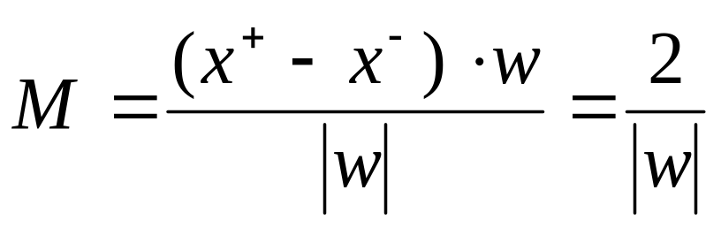
Linear SVM Mathematically
x⁺
M=Margin Width
“Predict Class = +1” zone
X⁻
wx+b=1
“Predict Class = -1” zone
wx+b=0
wx+b=-1
What we know:
w . x⁺ + b = +1
w . x⁻ + b = -1
w . (x⁺-x⁻⁾ = 2

Slide 10
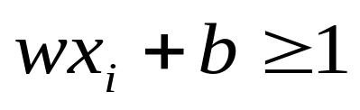
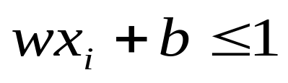
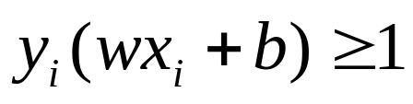
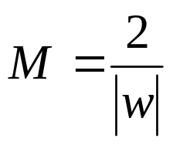
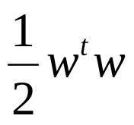
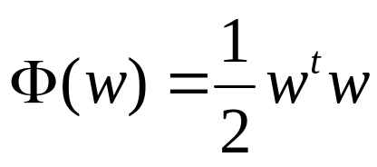


Linear SVM Mathematically
Goal: 1) Correctly classify all training data
if y_{i} = +1
if y_{i} = -1
for all i
2) Maximize the Margin
same as minimize
We can formulate a Quadratic Optimization Problem and solve for w and b
Minimize
subject to

Slide 11
Solving the Optimization Problem
Find w and b such that
Φ(w) =½ w^{T}w is minimized;
and for all {(x_{i} ,y_{i})}: y_{i} (w^{T}x_{i} + b) ≥ 1
Need to optimize a quadratic function subject to linear constraints.
Quadratic optimization problems are a well-known class of mathematical programming problems, and many (rather intricate) algorithms exist for solving them.
The solution involves constructing a dual problem where a Lagrange multiplier α_{i} is associated with every constraint in the primary problem:
Find α₁…α_{N} such that
Q(α) =Σα_{i} - ½ΣΣα_{i}α_{j}y_{i}y_{j}x_{i}^{T}x_{j} is maximized and
(1) Σα_{i}y_{i} = 0
(2) α_{i} ≥ 0 for all α_{i}

Slide 12
The Optimization Problem Solution
The solution has the form:
Each non-zero α_{i} indicates that corresponding x_{i} is a support vector.
Then the classifying function will have the form:
Notice that it relies on an inner product between the test point x and the support vectors x_{i} – we will return to this later.
Also keep in mind that solving the optimization problem involved computing the inner products x_{i}^{T}x_{j} between all pairs of training points.
w =Σα_{i}y_{i}x_{i} b= y_{k}- w^{T}x_{k} for any x_{k} such that α_{k}≠ 0
f(x) = Σα_{i}y_{i}x_{i}^{T}x + b

Slide 13
Dataset with noise
denotes +1
denotes -1
Hard Margin: So far we require all data points be classified correctly
- No training error
What if the training set is noisy?
- Solution 1: use very powerful kernels
OVERFITTING!

Slide 14
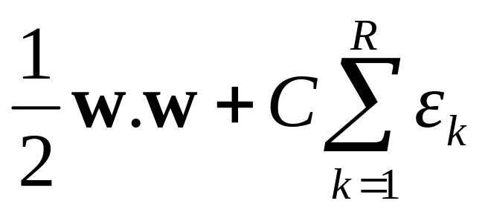
Soft Margin Classification
Slack variables ξi can be added to allow misclassification of difficult or noisy examples.
What should our quadratic optimization criterion be?
Minimize
ε₁₁
ε₂
wx+b=1
ε₇
wx+b=0
wx+b=-1

Slide 15
Hard Margin v.s. Soft Margin
The old formulation:
The new formulation incorporating slack variables:
Parameter C can be viewed as a way to control overfitting.
Find w and b such that
Φ(w) =½ w^{T}w is minimized and for all {(x_{i} ,y_{i})}
y_{i} (w^{T}x_{i} + b) ≥ 1
Find w and b such that
Φ(w) =½ w^{T}w + CΣξ_{i} is minimized and for all {(x_{i} ,y_{i})}
y_{i} (w^{T}x_{i} + b) ≥ 1- ξ_{i} and ξ_{i} ≥ 0 for all i

Slide 16
Linear SVMs: Overview
The classifier is a separating hyperplane.
Most “important” training points are support vectors; they define the hyperplane.
Quadratic optimization algorithms can identify which training points x_{i} are support vectors with non-zero Lagrangian multipliers α_{i}.
Both in the dual formulation of the problem and in the solution training points appear only inside dot products:
Find α₁…α_{N} such that
Q(α) =Σα_{i} - ½ΣΣα_{i}α_{j}y_{i}y_{j}x_{i}^{T}x_{j} is maximized and
(1) Σα_{i}y_{i} = 0
(2) 0 ≤ α_{i} ≤ C for all α_{i}
f(x) = Σα_{i}y_{i}x_{i}^{T}x + b

Slide 17
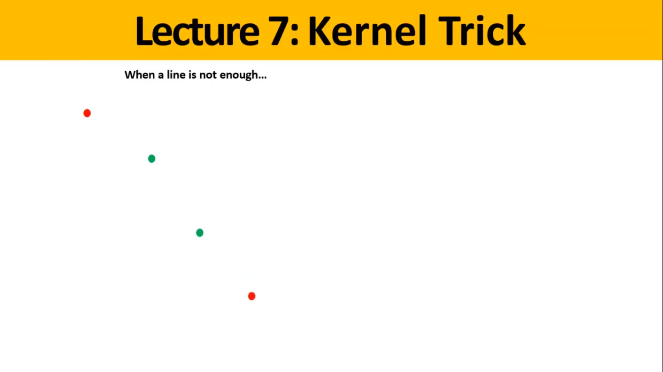

Slide 18
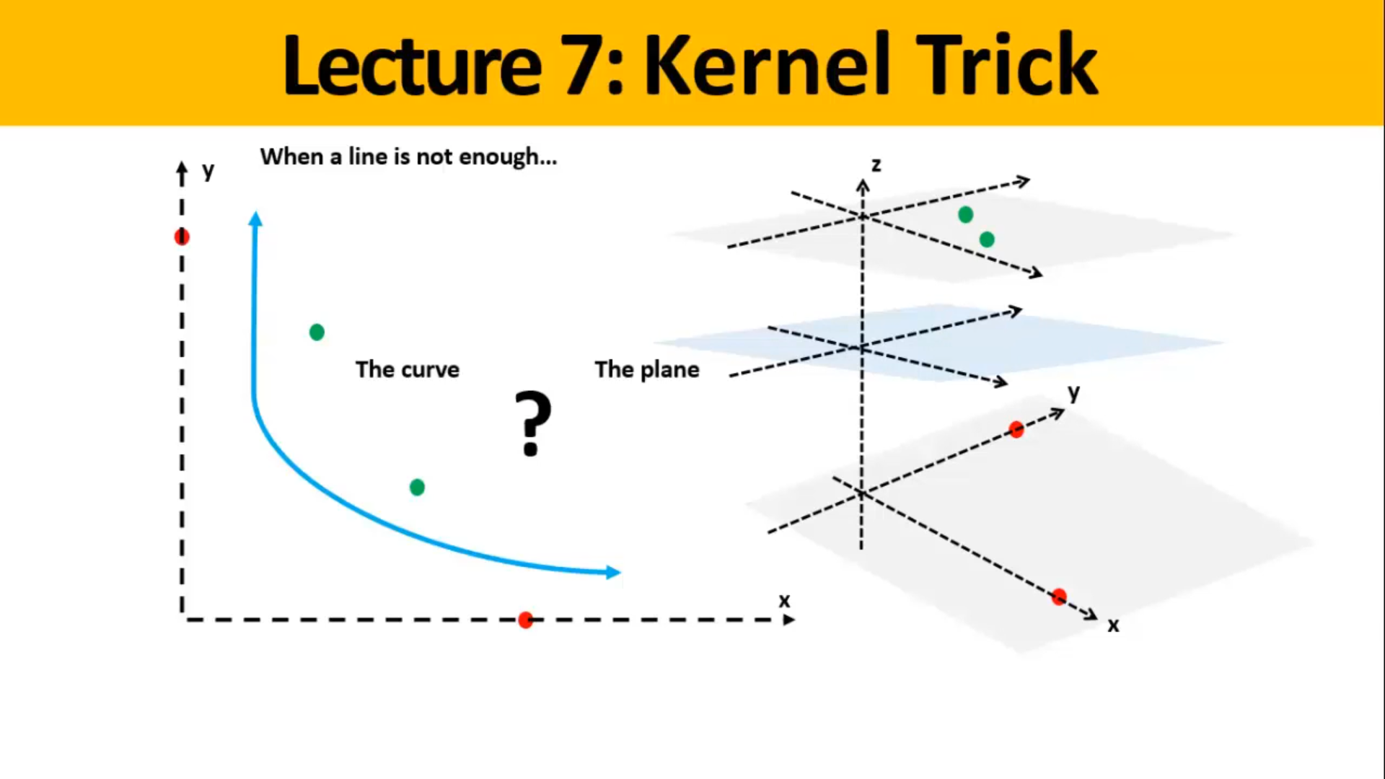

Slide 19
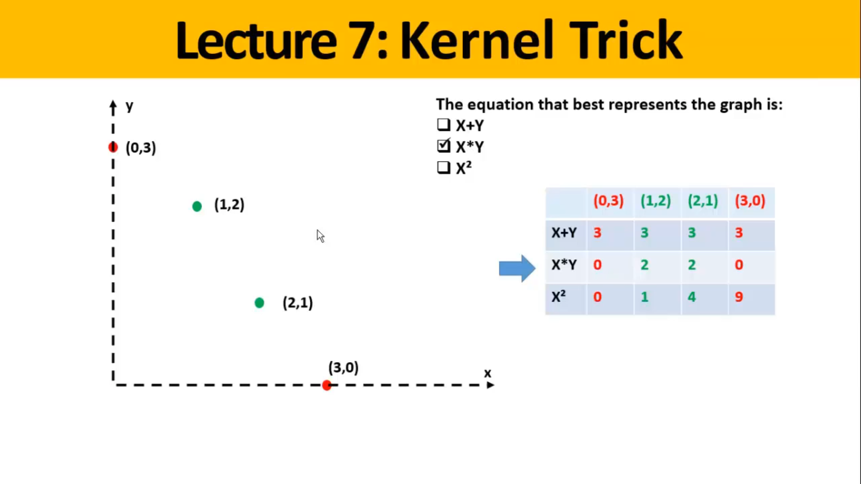

Slide 20
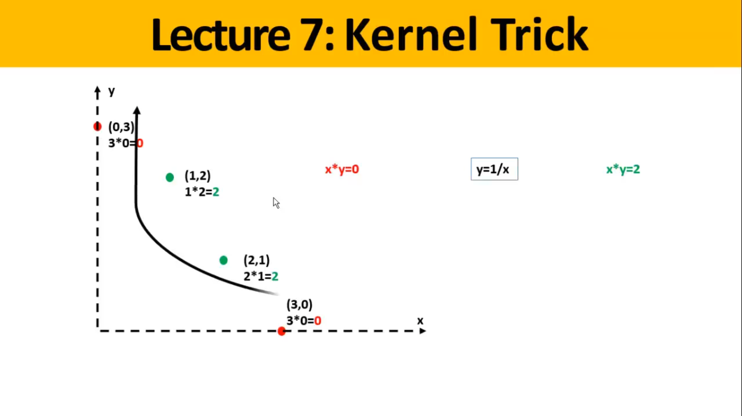

Slide 21
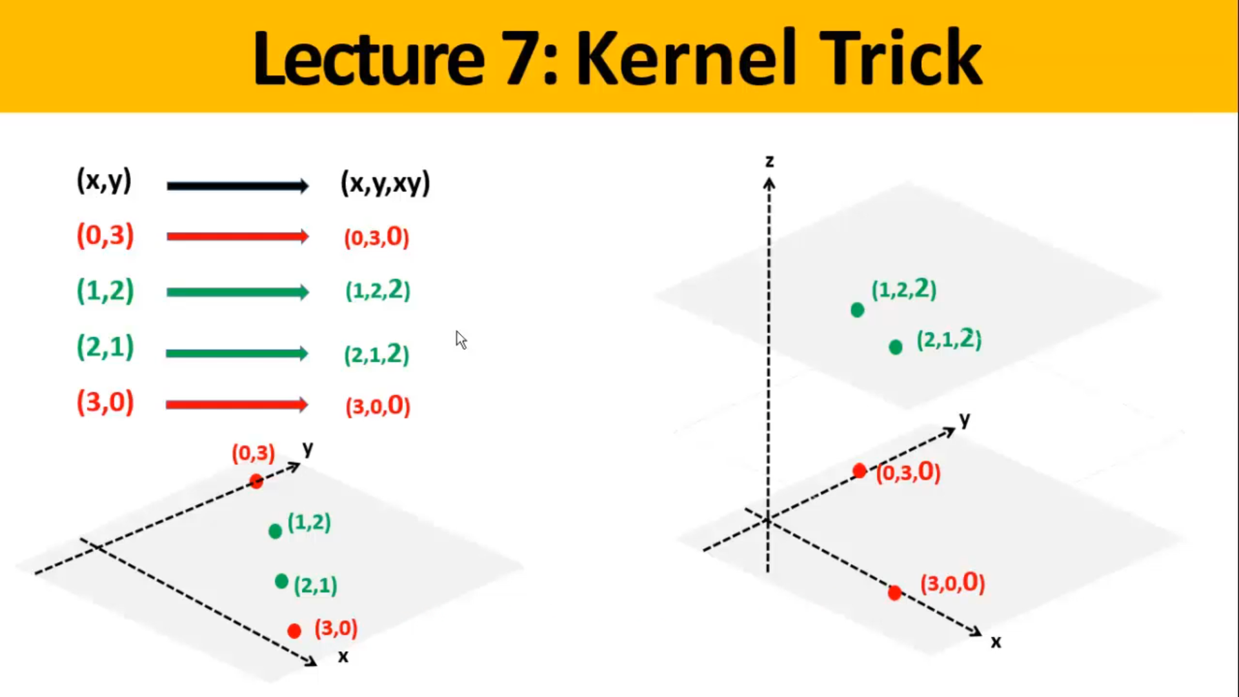

Slide 22
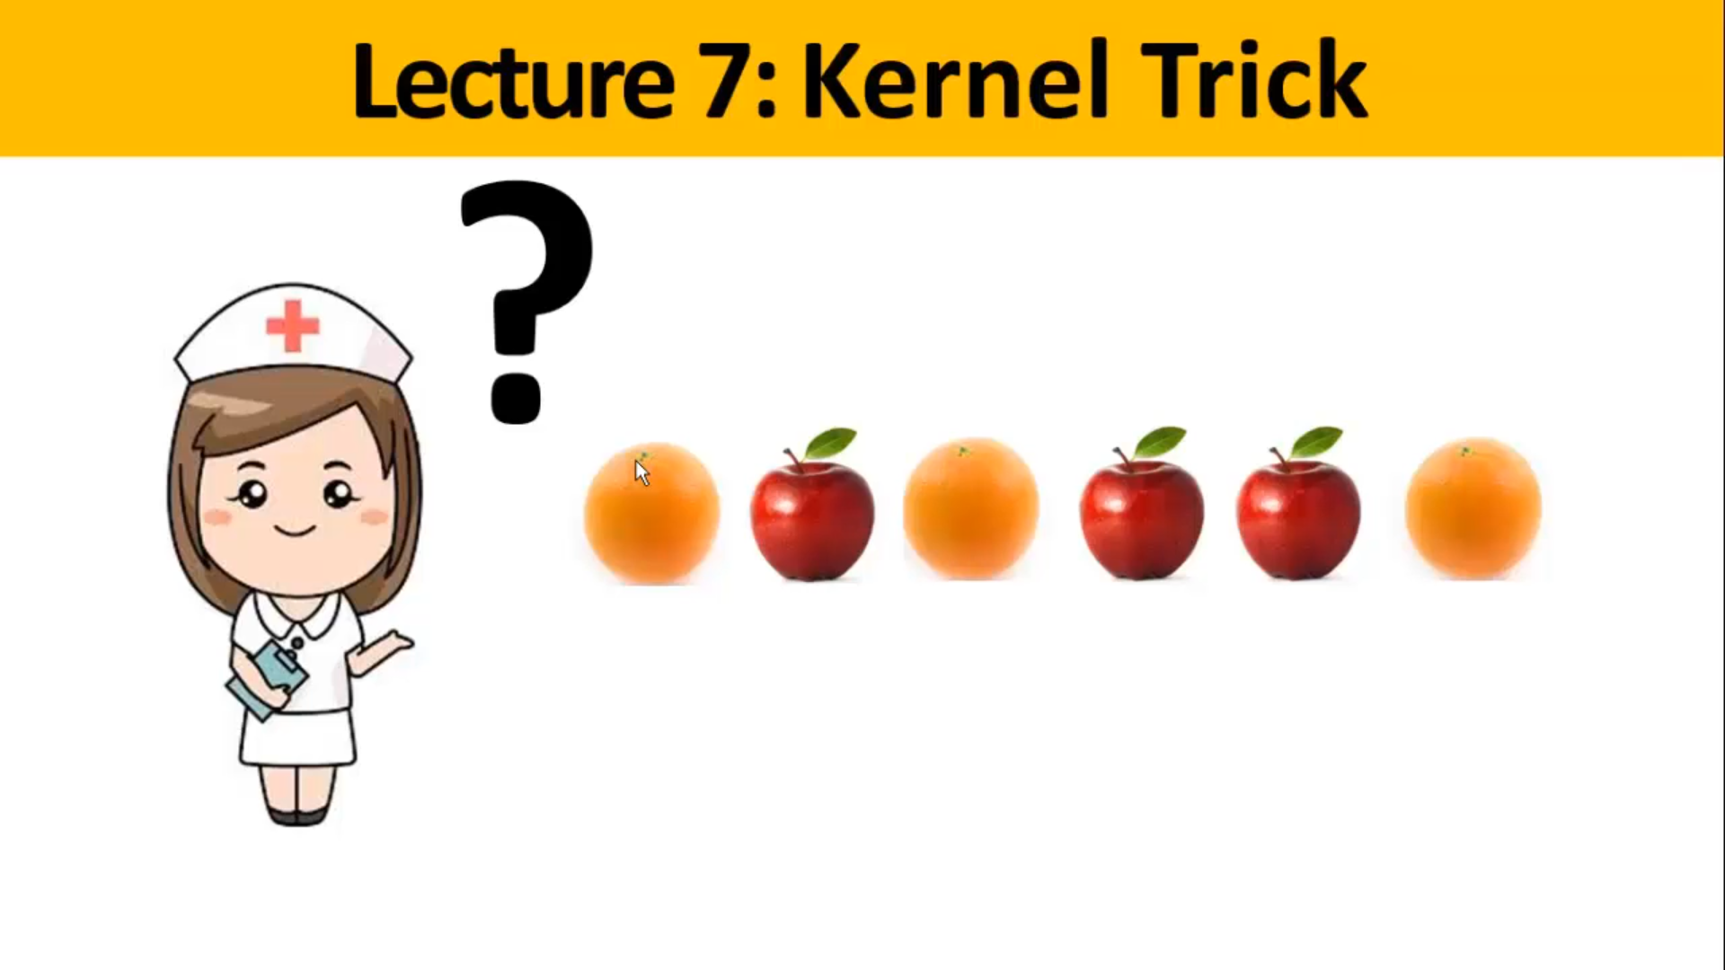

Slide 23
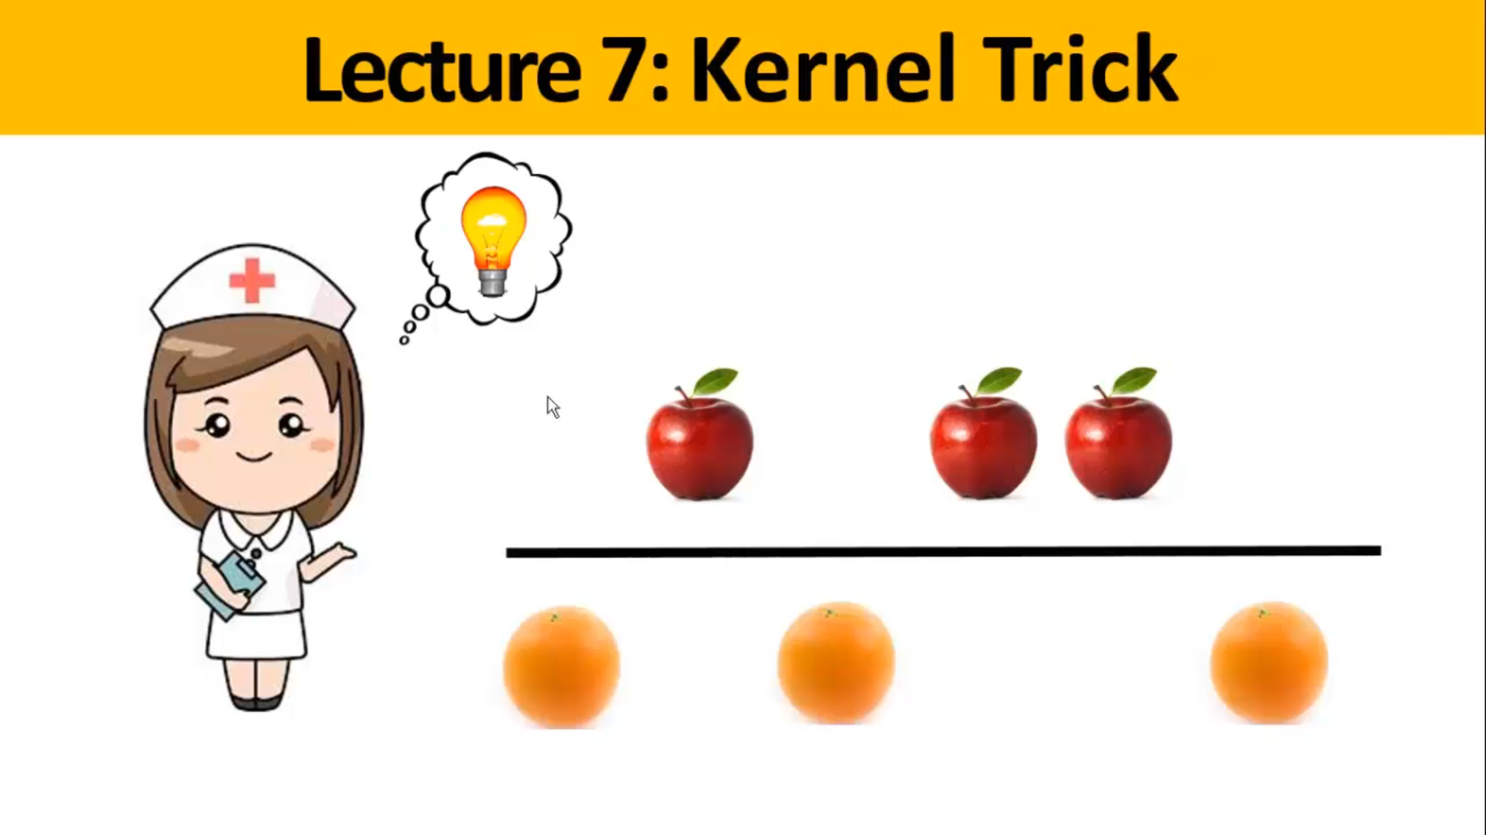

Slide 24
Non-linear SVMs
Datasets that are linearly separable with some noise work out great:
But what are we going to do if the dataset is just too hard?
How about… mapping data to a higher-dimensional space:
0
x
0
x
x²
0
x

Slide 25
Non-linear SVMs: Feature spaces
General idea: the original input space can always be mapped to some higher-dimensional feature space where the training set is separable:
Φ: x → φ(x)

Slide 26
The “Kernel Trick”
The linear classifier relies on dot product between vectors K(x_{i},x_{j})=x_{i}^{T}x_{j}
If every data point is mapped into high-dimensional space via some transformation Φ: x → φ(x), the dot product becomes:
K(x_{i},x_{j})= φ(x_{i}) ^{T}φ(x_{j})
A kernel function is some function that corresponds to an inner product in some expanded feature space.
Example:
2-dimensional vectors x=[x₁ x₂]; let K(x_{i},x_{j})=(1 + x_{i}^{T}x_{j})²,
Need to show that K(x_{i},x_{j})= φ(x_{i}) ^{T}φ(x_{j}):
K(x_{i},x_{j})=(1 + x_{i}^{T}x_{j})²,
= 1+ x_{i1}²x_{j1}² + 2 x_{i1}x_{j1} x_{i2}x_{j2}+ x_{i2}²x_{j2}² + 2x_{i1}x_{j1} + 2x_{i2}x_{j2}
= [1 x_{i1}² √2 x_{i1}x_{i2} x_{i2}² √2x_{i1} √2x_{i2}]^{T} [1 x_{j1}² √2 x_{j1}x_{j2} x_{j2}² √2x_{j1} √2x_{j2}]
= φ(x_{i}) ^{T}φ(x_{j}), where φ(x) = [1 x₁² √2 x₁x₂ x₂² √2x₁ √2x₂]

Slide 27
What Functions are Kernels?
For some functions K(x_{i},x_{j}) checking that
K(x_{i},x_{j})= φ(x_{i}) ^{T}φ(x_{j}) can be cumbersome.
Mercer’s theorem:
Every semi-positive definite symmetric function is a kernel
Semi-positive definite symmetric functions correspond to a semi-positive definite symmetric Gram matrix:
K(x₁,x₁) | K(x₁,x₂) | K(x₁,x₃) | … | K(x₁,x_{N})
K(x₂,x₁) | K(x₂,x₂) | K(x₂,x₃) |  | K(x₂,x_{N})
… | … | … | … | …
K(x_{N},x₁) | K(x_{N},x₂) | K(x_{N},x₃) | … | K(x_{N},x_{N})
K=

Slide 28
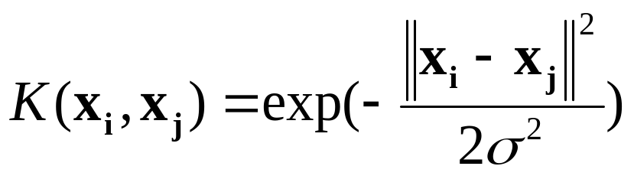
Examples of Kernel Functions
Linear: K(x_{i},x_{j})= x_{i} ^{T}x_{j}
Polynomial of power p: K(x_{i},x_{j})= (1+ x_{i} ^{T}x_{j})^{p}
Gaussian (radial-basis function network):
Sigmoid: K(x_{i},x_{j})= tanh(β₀x_{i} ^{T}x_{j} + β₁)

Slide 29
Non-linear SVMs Mathematically
Dual problem formulation:
The solution is:
Optimization techniques for finding α_{i}’s remain the same!
Find α₁…α_{N} such that
Q(α) =Σα_{i} - ½ΣΣα_{i}α_{j}y_{i}y_{j}K(x_{i}, x_{j}) is maximized and
(1) Σα_{i}y_{i} = 0
(2) α_{i} ≥ 0 for all α_{i}
f(x) = Σα_{i}y_{i}K(x_{i}, x_{j})+ b

Slide 30
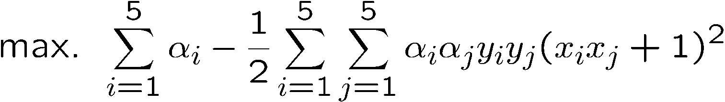
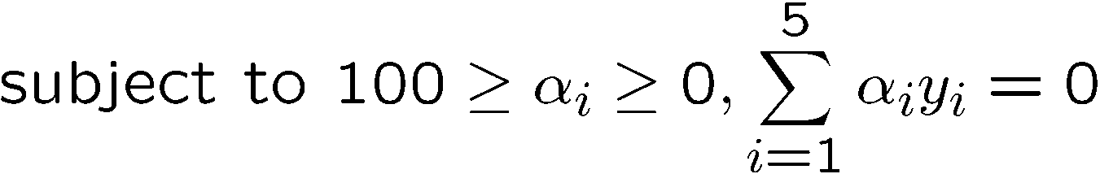
Example
Suppose we have 5 one-dimensional data points
  x₁=1, x₂=2, x₃=4, x₄=5, x₅=6, with 1, 2, 6 as class 1 and 4, 5 as class 2 ⇒ y₁=1, y₂=1, y₃=-1, y₄=-1, y₅=1
We use the polynomial kernel of degree 2
  K(x,y) = (xy+1)²
  C is set to 100
We first find α_{i} (i=1, …, 5) by
Notes:
H =
4 9 -25 -36 49
9 25 -81 -121 169
-25 -81 289 441 -625
-36 -121 441 676 -961
49 169 -625 -961 1369

Slide 31



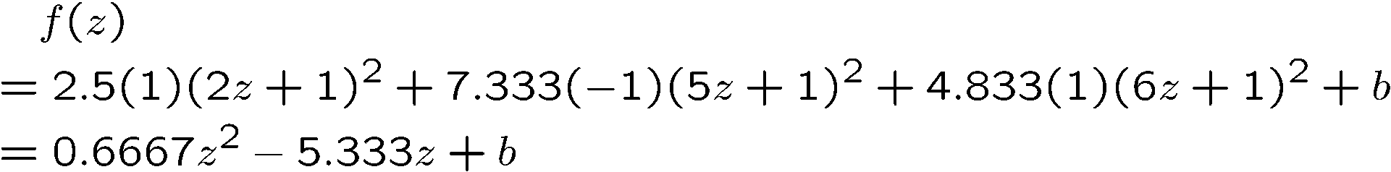


Example
By using a QP solver, we get
  α₁=0, α₂=2.5, α₃=0, α₄=7.333, α₅=4.833
  Note that the constraints are indeed satisfied
  The support vectors are {x₂=2, x₄=5, x₅=6}
The discriminant function is
b is recovered by solving f(2)=1 or by f(5)=-1 or by f(6)=1, as x₂ and x₅ lie on the line and x₄ lies on the line
All three give b=9
Notes:
The optimization toolbox of matlab contains a quadratic programming solver

Slide 32
Example
Value of discriminant function
class 1
class 2
class 1
1
2
4
5
6

Slide 33
Nonlinear SVM - Overview
SVM locates a separating hyperplane in the feature space and classify points in that space
It does not need to represent the space explicitly, simply by defining a kernel function
The kernel function plays the role of the dot product in the feature space.

Slide 34
Properties of SVM
Flexibility in choosing a similarity function
Sparseness of solution when dealing with large data sets
- only support vectors are used to specify the separating hyperplane
Ability to handle large feature spaces
- complexity does not depend on the dimensionality of the feature space
Overfitting can be controlled by soft margin approach
Nice math property: a simple convex optimization problem which is guaranteed to converge to a single global solution
Feature Selection

Slide 35
SVM Applications
SVM has been used successfully in many real-world problems
- text (and hypertext) categorization
- image classification
- bioinformatics (Protein classification,
Cancer classification)
- hand-written character recognition

Slide 36
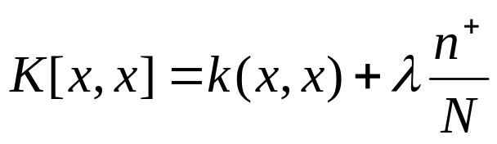
Application 1: Cancer Classification
High Dimensional
- p>1000; n<100
Imbalanced
- less positive samples
Many irrelevant features
Noisy
Genes
Patients | g-1 | g-2 | …… | g-p
P-1
p-2
…….
p-n
FEATURE SELECTION
In the linear case,
w_{i}² gives the ranking of dim i
SVM is sensitive to noisy (mis-labeled) data ☹

Slide 37
Weakness of SVM
It is sensitive to noise
- A relatively small number of mislabeled examples can dramatically decrease the performance
It only considers two classes
- how to do multi-class classification with SVM?
- Answer:
1) with output arity m, learn m SVM’s
  SVM 1 learns “Output==1” vs “Output != 1”
  SVM 2 learns “Output==2” vs “Output != 2”
  :
  SVM m learns “Output==m” vs “Output != m”
2)To predict the output for a new input, just predict with each SVM and find out which one puts the prediction the furthest into the positive region.

Slide 38
Application 2: Text Categorization
Task: The classification of natural text (or hypertext) documents into a fixed number of predefined categories based on their content.
- email filtering, web searching, sorting documents by topic, etc..
A document can be assigned to more than one category, so this can be viewed as a series of binary classification problems, one for each category

Slide 39

Representation of Text
IR’s vector space model (aka bag-of-words representation)
A doc is represented by a vector indexed by a pre-fixed set or dictionary of terms
Values of an entry can be binary or weights
Normalization, stop words, word stems
Doc x => φ(x)

Slide 40
Text Categorization using SVM
The distance between two documents is φ(x)·φ(z)
K(x,z) = 〈φ(x)·φ(z) is a valid kernel, SVM can be used with K(x,z) for discrimination.
Why SVM?
-High dimensional input space
-Few irrelevant features (dense concept)
-Sparse document vectors (sparse instances)
-Text categorization problems are linearly separable

Slide 41
Some Issues
Choice of kernel
- Gaussian or polynomial kernel is default
- if ineffective, more elaborate kernels are needed
- domain experts can give assistance in formulating appropriate similarity measures
Choice of kernel parameters
- e.g. σ in Gaussian kernel
- σ is the distance between closest points with different classifications
- In the absence of reliable criteria, applications rely on the use of a validation set or cross-validation to set such parameters.
Optimization criterion – Hard margin v.s. Soft margin
- a lengthy series of experiments in which various parameters are tested

Slide 42
Additional Resources
An excellent tutorial on VC-dimension and Support Vector Machines:
    C.J.C. Burges. A tutorial on support vector machines for pattern recognition. Data Mining and Knowledge Discovery, 2(2):955-974, 1998.
The VC/SRM/SVM Bible:
Statistical Learning Theory by Vladimir Vapnik, Wiley-Interscience; 1998
http://www.kernel-machines.org/

Slide 43
Reference
Support Vector Machine Classification of Microarray Gene Expression Data, Michael P. S. Brown William Noble Grundy, David Lin, Nello Cristianini, Charles Sugnet, Manuel Ares, Jr., David Haussler
www.cs.utexas.edu/users/mooney/cs391L/svm.ppt
Text categorization with Support Vector Machines:
learning with many relevant features
T. Joachims, ECML - 98

